Slide 1

Service Provider Playbook

Slide 2

Service Provider Offerings
12
Service Providers
6 Categories
3 Technology
2 Financial & Legal
2 Market & Data Intelligence
2 Marketing
2 HR & Health Insurance
1 Continuing Education

Slide 3


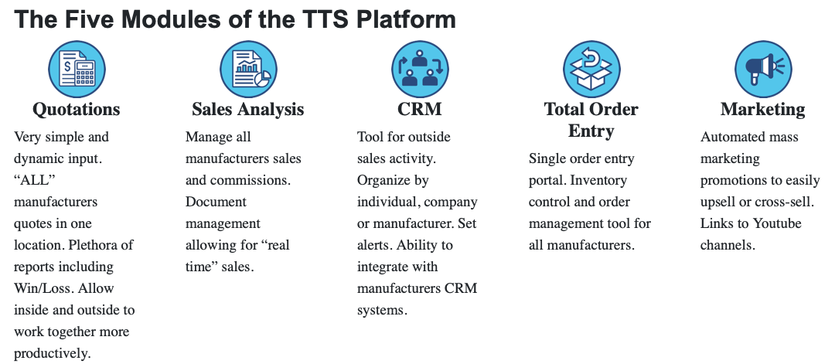
TTS
The TTS Platform can be called the electrical manufacturer's reps ERP system!
No other software solution does all 5 functions – Quotations, Sales Analysis, CRM, Total Order Entry and Marketing. Integrated pipeline management means more efficient and effective sales strategies for you!
Trade Tech Solutions | NEMRA Technology Service Provider

Slide 4


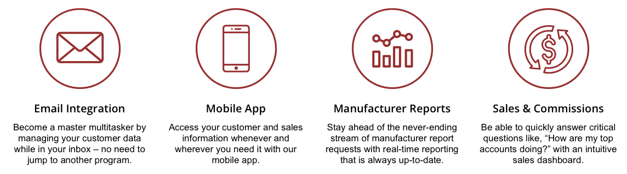
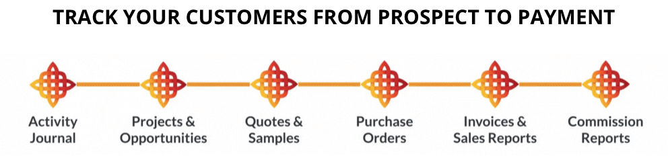
REPFABRIC
A CRM and Sales Data Management Platform Built for Manufacturers' Sales Reps
As reps, we understand the complexities of repping multiple manufacturers. That’s why we created Repfabric, the CRM, sales reporting, and commission tracking tool uniquely tailored to the needs of manufacturer sales reps.
Repfabric | NEMRA Technology Service Provider

Slide 5


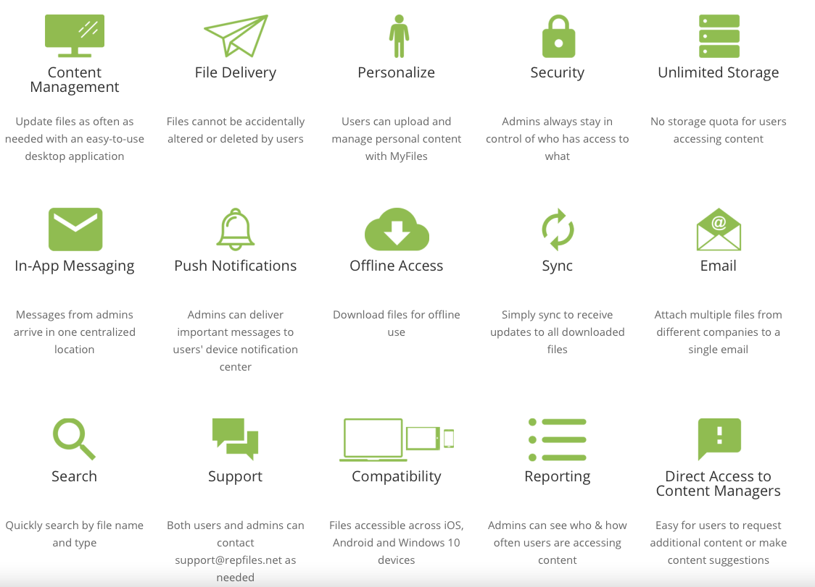
REPFILES
RepFiles enables manufacturers to populate and manage the content on thousands of outside salespeople's devices.
Salespeople no longer need to learn different systems, manage multiple logins or move in and out of various apps when they need to access content in front of a customer.
Under a single account within a single app, RepFiles gives salespeople a one-stop shop
RepFiles | NEMRA Technology Service Provider

Slide 6


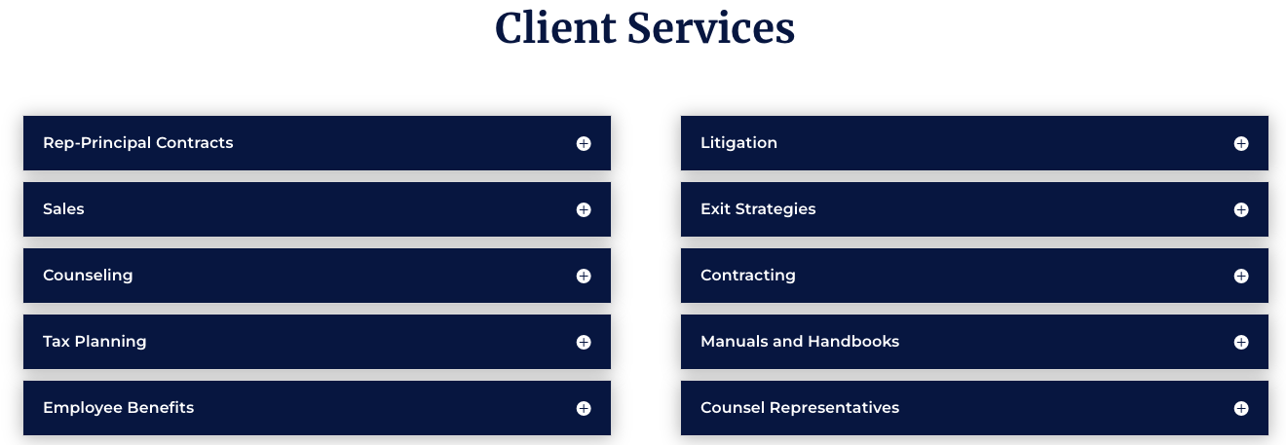
SFBBG
Recover unpaid and underpaid commissions.
Prepare and negotiate rep contracts that will help avoid disputes later.
Counsel rep firms on succession planning, acquisitions and sales, tax issues, non-competes, and virtually all other rep issues.
SFBBG | NEMRA Legal Services Provider

Slide 7


T.I.P.S. 4 REPS
T.I.P.S. 4 Reps has developed a custom designed review and process- oriented analysis in each of the Tax, Investment, Pension and Succession Planning disciplines, for reps.
Tax Planning- CASH Management
Investment Management
Pension Planning
Succession Planning
REP Management (Retirement and Exit Plan)
RISK Management (Retention, Incentive and Succession of Key People)
T.I.P.S 4 Reps | NEMRA Legal Services Provider

Slide 8



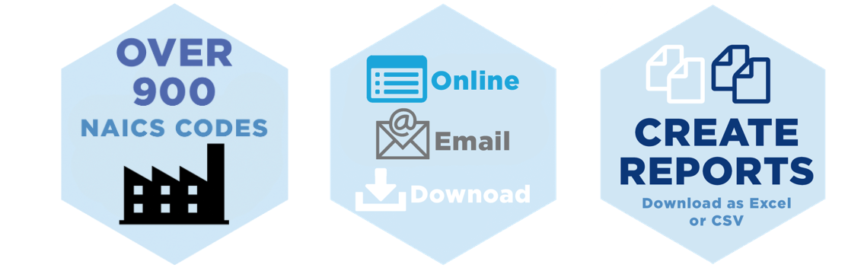
DISC CORP
DISC CORP has been the leading provider of electrical wholesaling industry forecasting – by national & regional market segmentation (customer type) and NAICS industry codes.
The DISC CORP suite of applications is ideal for Electrical Distributors, Electrical Manufacturers, Electrical Manufacturers’ Representatives, Financial Analysts, Contractors, Sales Rep Agencies, and beyond.
DISC | NEMRA Market and Data Intelligence Service Provider

Slide 9

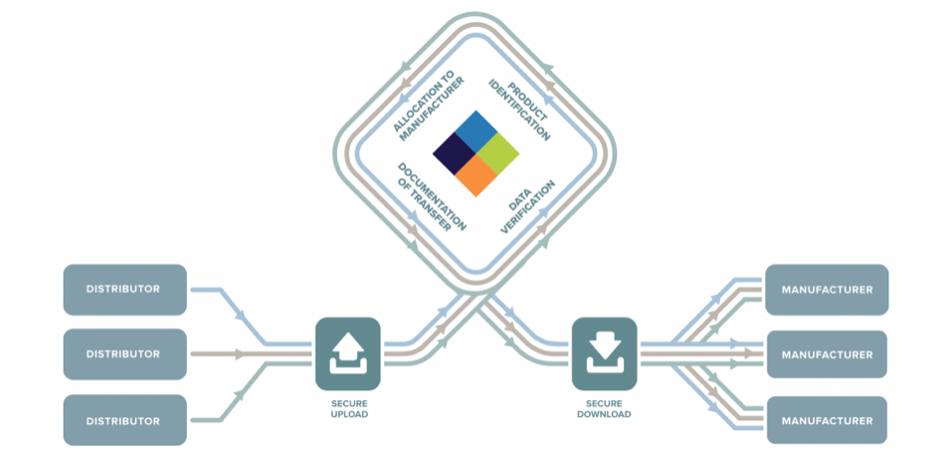
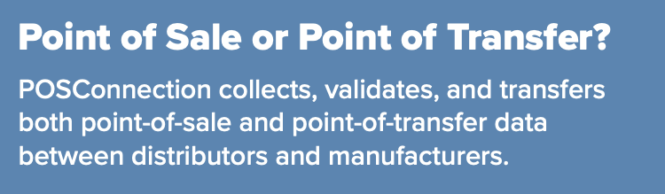
POS Connection
The POS Connection provides a secure industry hub for POS capture and standardization of POS data. Enabling the manufacturer to provide their reps with accurate and timely compensation calculations.
POS Connection provides a streamlined, standardized data collection and reporting platform that connects manufacturers and distributors.
POS Connection | NEMRA Market and Data Intelligence Service Provider

Slide 10

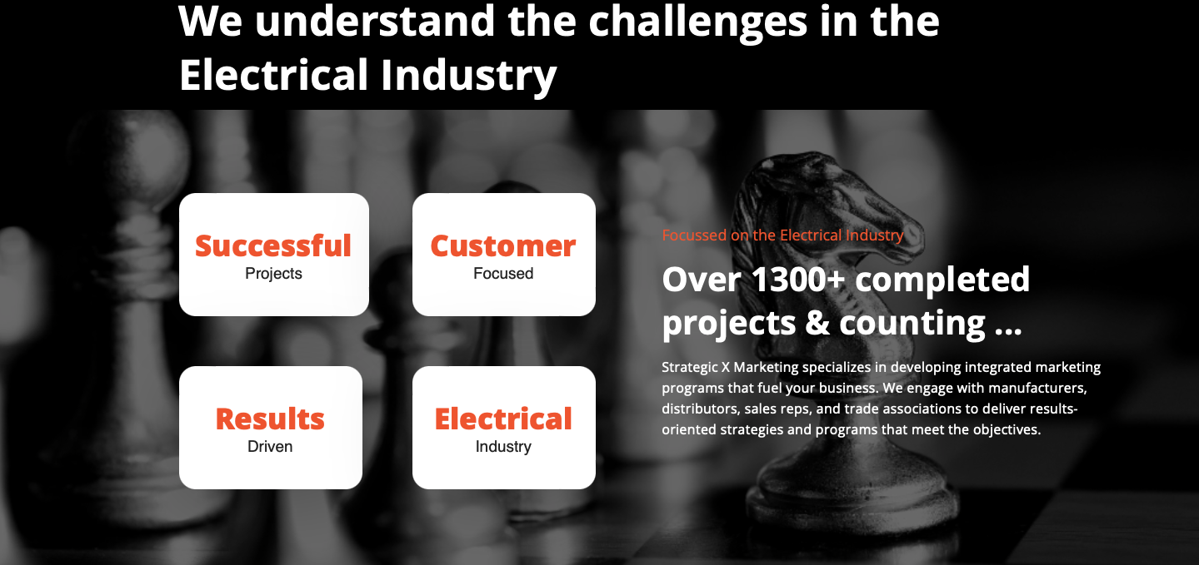
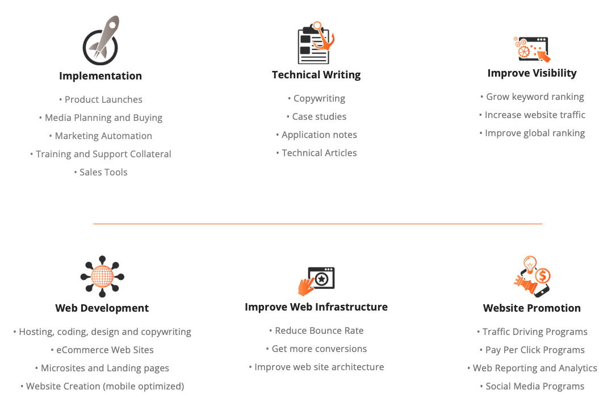
Strategic X
Strategic X Marketing is a full-service marketing firm that helps you do more – with the results you expect.
Our experience and program examples demonstrate our track record of proven performance.
More importantly, they all mean one thing for you; no risk–simply the results you are looking for at an affordable price.
Strategic X | NEMRA Marketing Services Provider

Slide 11

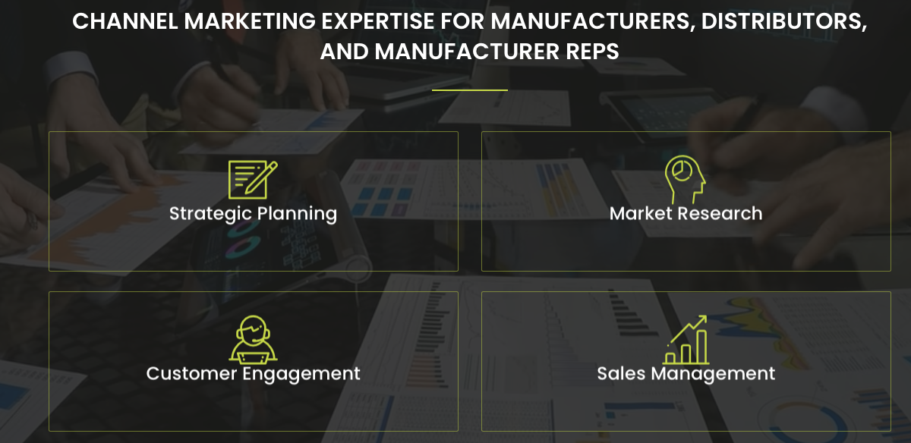
Channel Marketing Group
Channel Marketing Group offers strategy and marketing consulting services to manufacturers, distributors, manufacturers reps, and associations focused on the electrical, lighting, HVAC, and plumbing industries.
CMG | NEMRA Marketing Services Provider

Slide 12


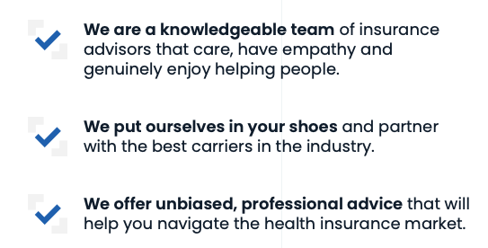
LIG SOLUTIONS
LIG Solutions Offers Comprehensive Health Coverage Options For The Members Of NEMRA.
Major Medical Insurance (ACA compliant)
Short-Term Policies (non-ACA compliant)
Medicare/Medicare Advantage*
Vision Insurance
Dental Insurance
Critical Illness
Hospitalization Insurance
Life Insurance
Other Supplemental Health Insurance Coverages
Health Reimbursement Arrangements (HRAs)/Group Programs
LIG SOLUTIONS | NEMRA Health Insurance Services Provider

Slide 13

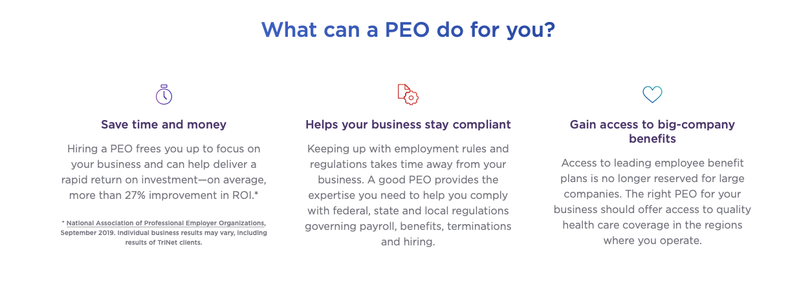
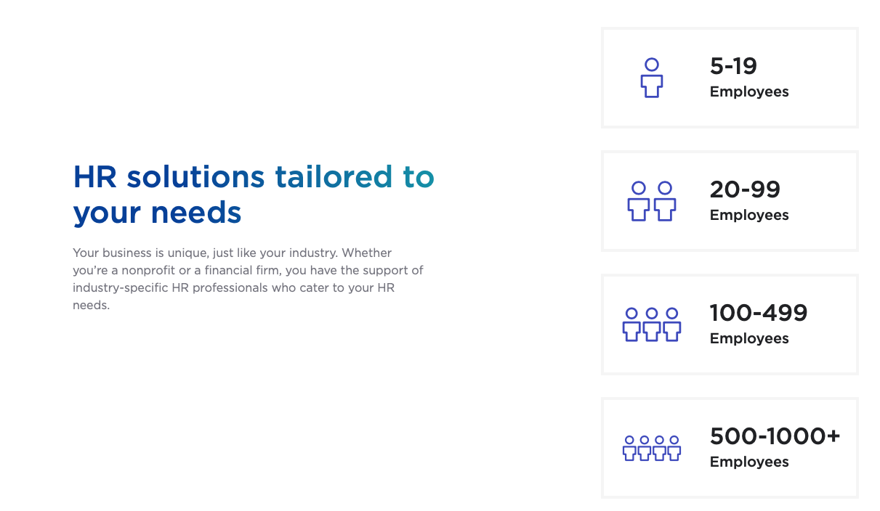
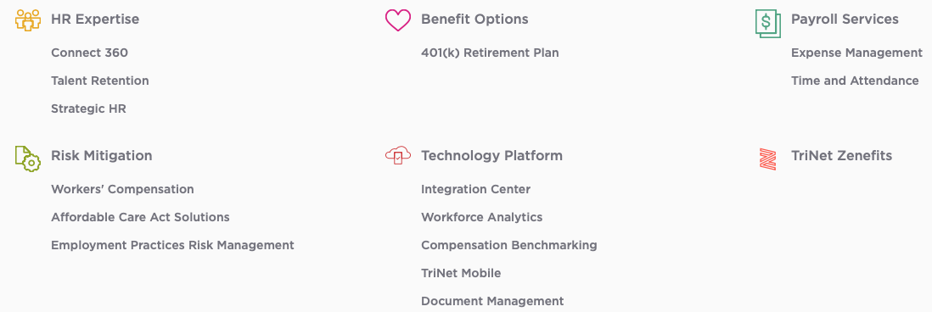
TRINET
TriNet is a professional employer organization, or PEO, that provides small and medium-size businesses (SMBs) with full-service HR solutions tailored by industry.
TRINET | NEMRA PEO Services Provider

Slide 14




IPA / MRERF
The CPMR designee has demonstrated organizational management skills by completing the demanding, three-year certification program while still maintaining day-to-day business. CPMR graduates subscribe to the stringent requirements of their common Code of Ethics, thus safeguarding the integrity of their firm and the factories they represent.
Learn how to become your customer’s business partner and strengthen your key account relationships to increase sales. In today’s highly competitive and ever-changing marketplace, buyers expect more from you – more information, more expertise and more professionalism. They demand value not only in your products and services, but in your relationship with them as well.
Many manufacturers struggle to engage with their independent sales reps. From not meeting sales expectations to shifting priorities to reporting, it’s not uncommon for sales leaders to become frustrated with the independent sales rep model. the MBP program gives you the tools and processes you need to create strategic partnerships with your reps, so you can increase your sales.
IPA / MRERF | NEMRA PROFESSIONAL DEVELOPMENT PROVIDER

